Slide 1
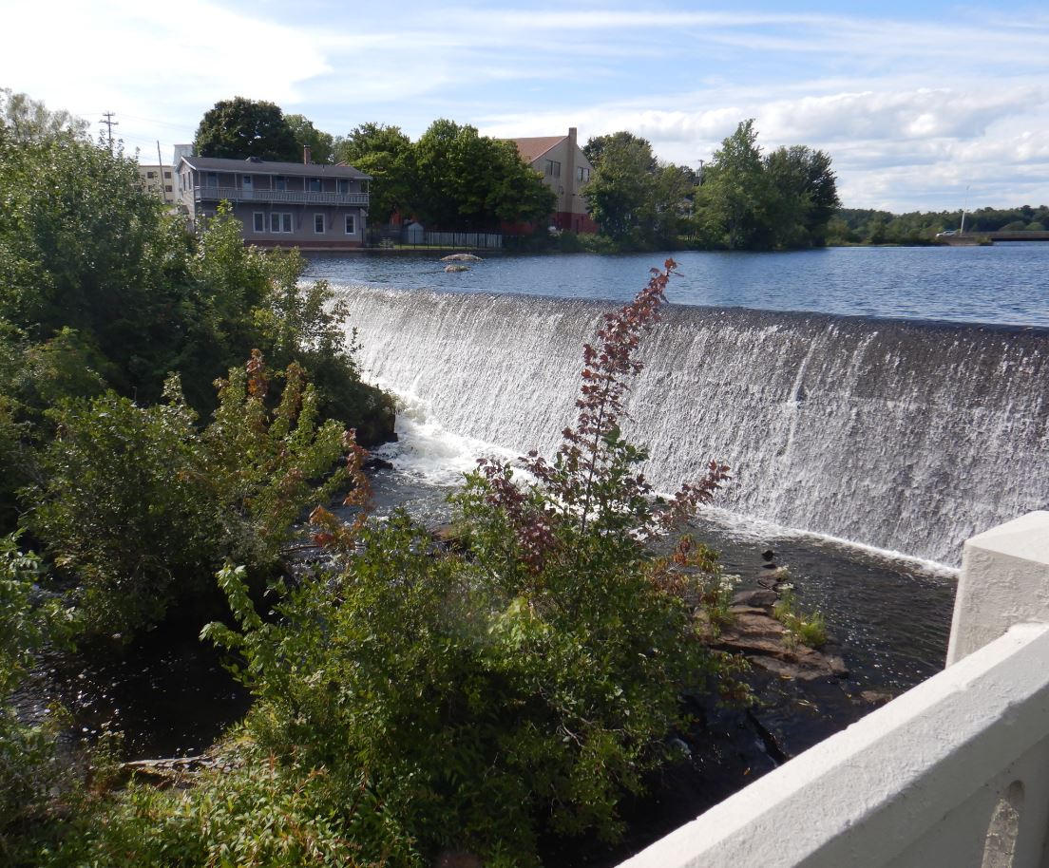
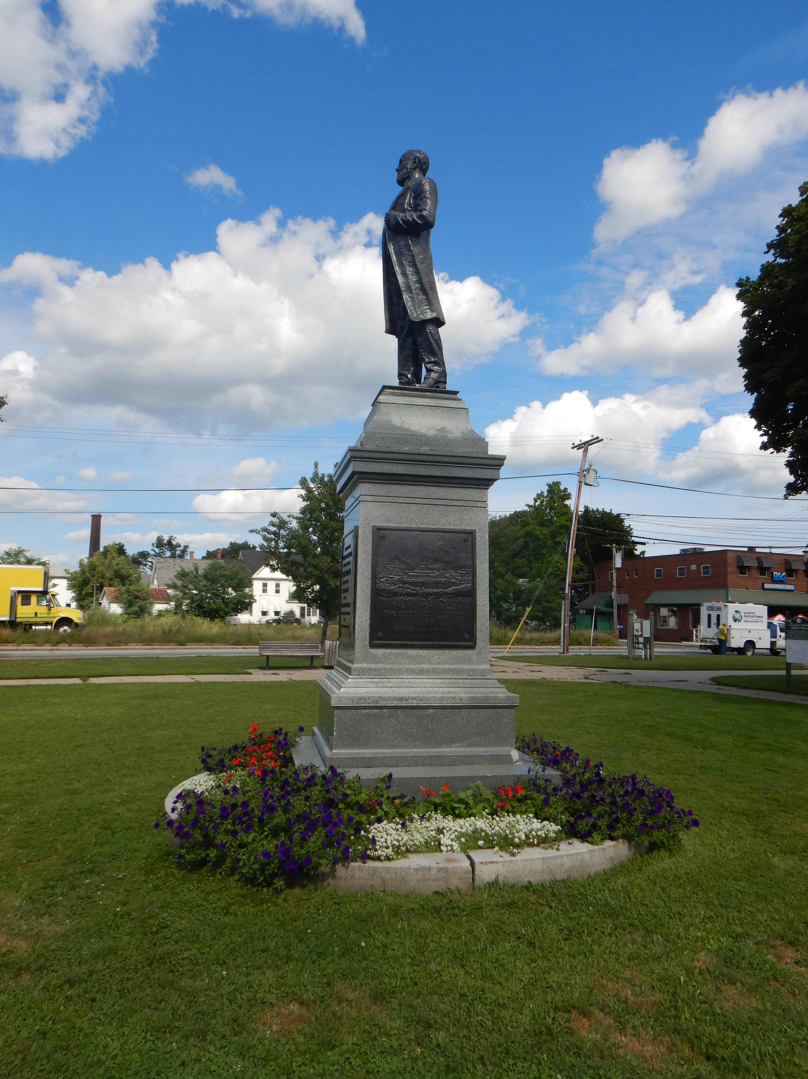


Sanford Downtown Raise Grant Improvement projects
Ernie Martin
MaineDOT
Senior Project Manager

Slide 2
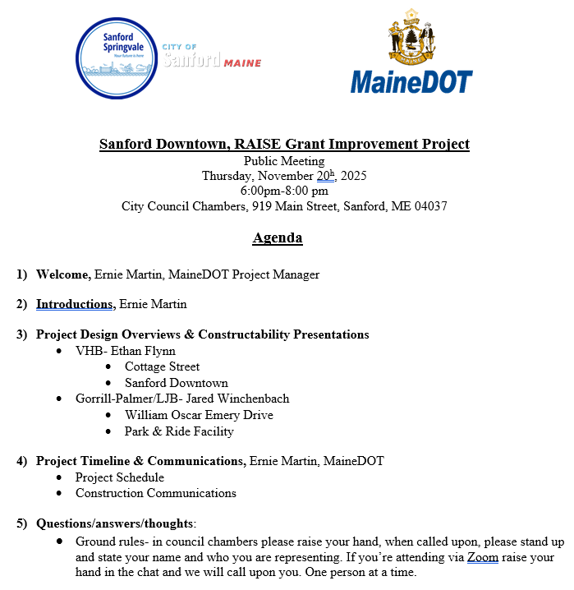
Meeting Agenda
Notes:
Housekeeping items: sign in, copies of the agenda, comments card with self stamped addressed envelopes

Slide 3
Introductions of Project Design Teams & Agenda
City of Sanford
Matt Hill, City Engineer
Matt Provencher, Assistant City Engineer
VHB
Tony Grande
Ethan Flynn
Gorrill-Palmer
Don Ettinger
Jared Winchenbach
Notes:
Make sure Steve introduces City and legislative personnel.

Slide 4
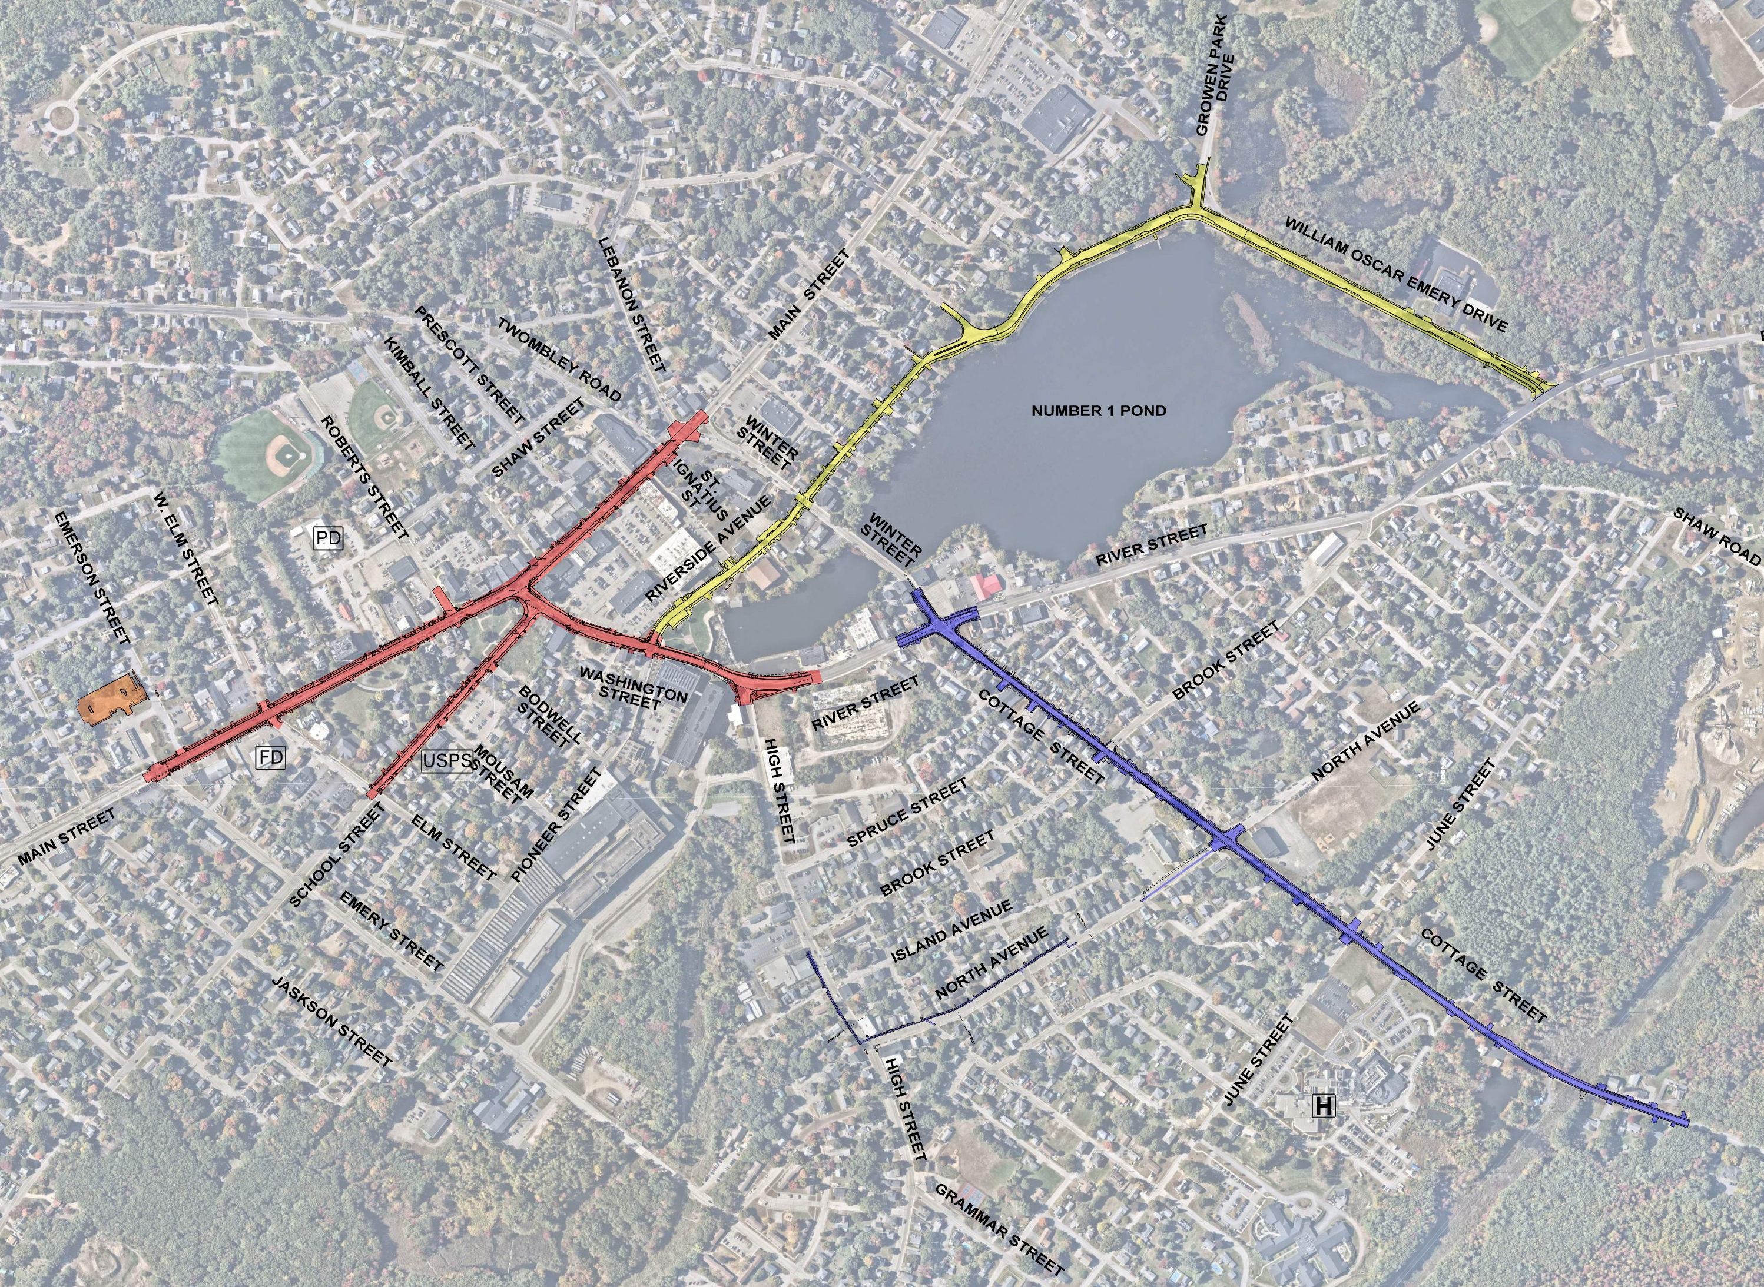
Project Components
Downtown Improvements
Cottage Street
William Oscar Emery Drive &
Riverside Avenue
Park and Ride
Notes:
Good evening, I am Ernie Martin, a Project Manager for the Maine Department of Transportation. We are here tonight for the preliminary public hearing to present and receive comments for the Sanford Raise Grant Project. The project consist of 4 projects. The Department is the design lead for the Main Street(downtown) and Cottage Street (Route 202) projects. The City of Sanford is locally administering the designs for William Oscar Emery Drive, Riverside Avenue and a park and ride along Emerson Street.
The purpose of this project is to provide economic opportunity and quality of life to the City of Sanford with the safest and most reliable transportation possible within the given resources.

Slide 5
Scope Refresher
Downtown Improvements
Roadway & Sidewalk reconstruction
Sidewalk Bumpouts to better define pedestrian crossings and parking
Drainage Improvements
Signal Improvements
Widening of Mousam River Bridges
Multi-Use Path along Washington and River St from Riverside Ave to project limits
Cottage Street
Roadway & Sidewalk reconstruction
Backcurb/retaining wall reconstruction
Drainage Improvements
Signal Improvements
New RRFB near St. Thomas School
William Oscar Emery Drive & Riverside Avenue
Roadway & sidewalk reconstruction
10-foot wide multi-use path along Riverside Ave & William Oscar Emery Drive (pond side) for the project limits.
Bump-outs to define limits of on-street parking.
Replace the existing roundabout with a T-intersection that repurposes the area with additional green space.
Large culvert replacement.
Drainage improvements.
Pedestrian scale lighting and landscaping.
Park and Ride
Reconstruction of existing gravel parking lot.
Drainage improvements.
Sidewalk accommodations.
Provisions for a new bus stop.
Lighting and landscaping.
Notes:
Good evening, I am Ernie Martin, a Project Manager for the Maine Department of Transportation. We are here tonight for the preliminary public hearing to present and receive comments for the Sanford Raise Grant Project. The project consist of 4 projects. The Department is the design lead for the Main Street(downtown) and Cottage Street (Route 202) projects. The City of Sanford is locally administering the designs for William Oscar Emery Drive, Riverside Avenue and a park and ride along Emerson Street.
The purpose of this project is to provide economic opportunity and quality of life to the City of Sanford with the safest and most reliable transportation possible within the given resources.

Slide 6
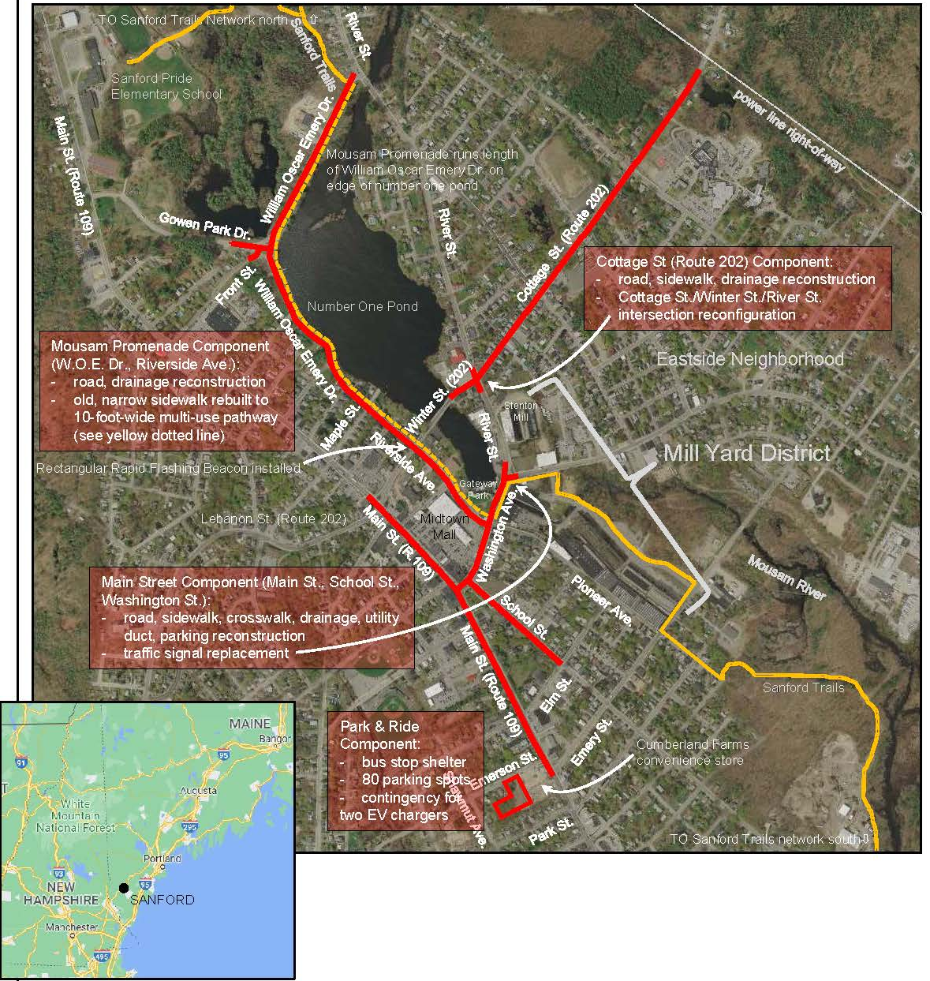
Construction phasing
Step 1 – Cottage St. (Blue)
1-way EB from River St to June St
Will require a WB detour
Will require short-term closures at night for utilities
Step 2 – Downtown Improvements (Red)
Until bump-outs are constructed shifted 2-way traffic is possible with loss of parking adjacent to the work area.
1-way roadways with detours
Step 3 – Riverside Ave. & William Oscar Emery Dr. (Yellow)
Will be constructed with alternating 1-way closure or block-by-block roadway closures with local access only.
Park and Ride (Orange)
Has a flexible schedule
Will be done concurrently with one of the previous steps

Slide 7
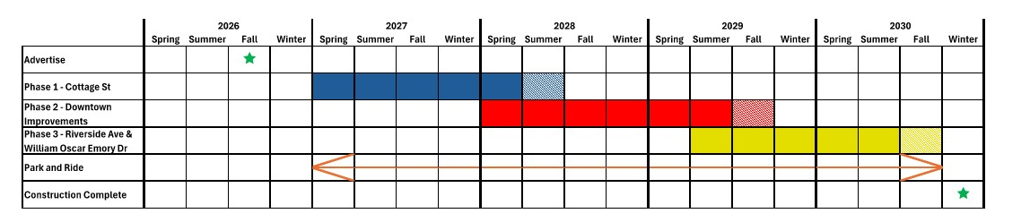
Construction Schedule

Slide 8
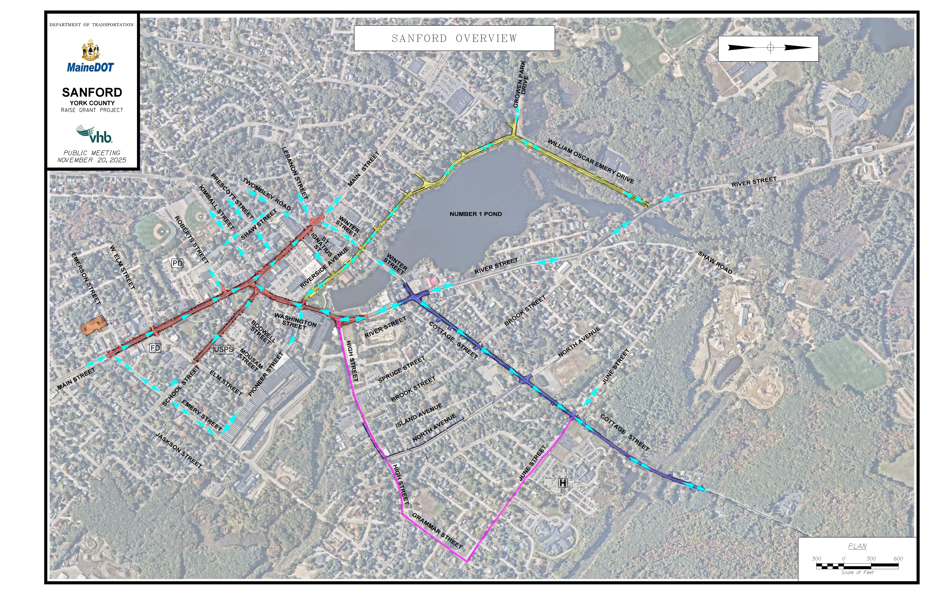
Cottage street
Spring 2027 to Summer 2028
Substantial Completion expected by end of 2027
One-way, EB only, from River St to June St. WB detours along June, Grammar, and High St.
During the detour, signal timing changes may be required at the High, Washington, River St Intersection
There will be drainage improvements along portions of North Ave and High St

Slide 9
Downtown Improvements
Spring 2028 to Fall 2029
Substantial Completion expected by Spring of 2029
One-way traffic on Main, Washington, and School St.
Washington St, between Main and School St, will remain two-way
During construction, signal timing changes may be required at multiple intersections
Change first block of Pioneer St to one-way away from Washington St
Temporarily extend School St one-way to Emery St
Change first block of Kimball and Twombley to one-way away from Main St

Slide 10
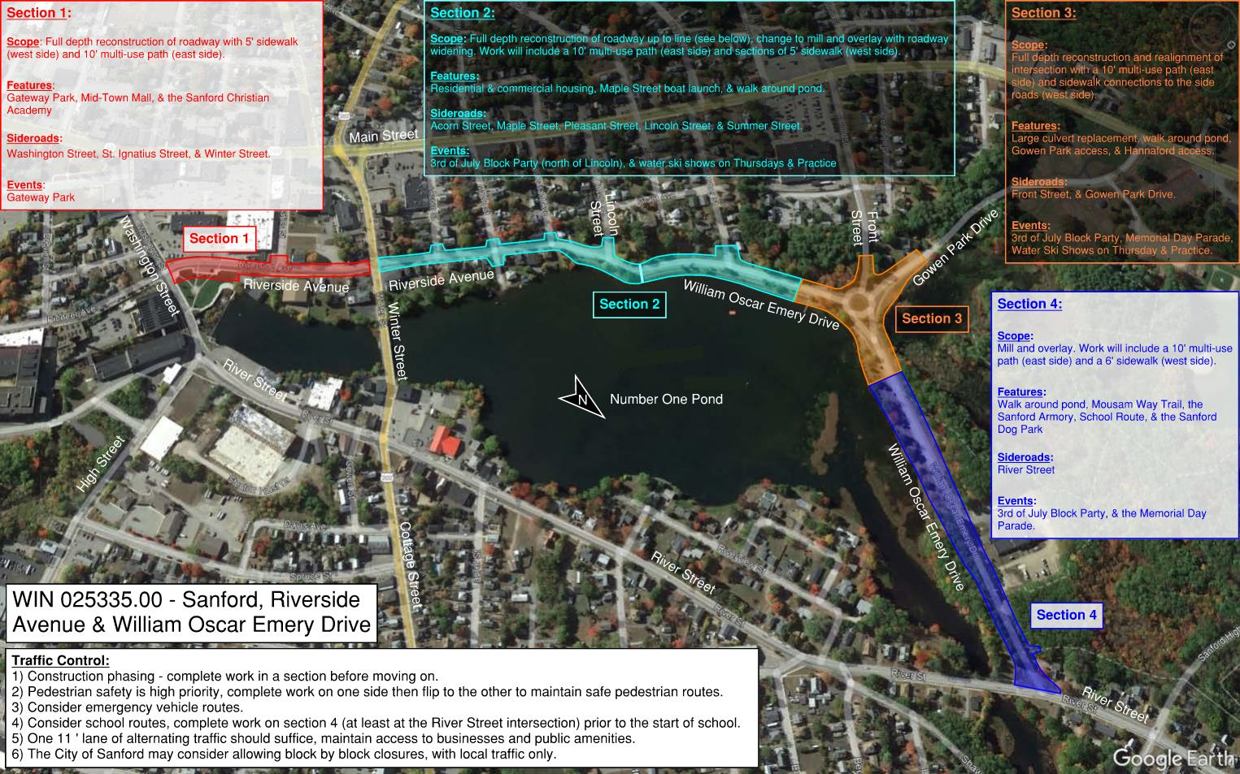
Riverside Avenue & WOE Drive
Summer 2029 to Fall 2030.
Substantial Completion expected by Summer of 2030.
Construction is expected to be completed in sections.
Order of sections will be left to the contractor.
Section 1 may be constructed as part of the downtown improvements due to proximity.
Traffic control will be more flexible, likely a combination of:
1-lane alternating traffic (with flaggers)
Block-by-block closures with through access for local traffic only.

Slide 11
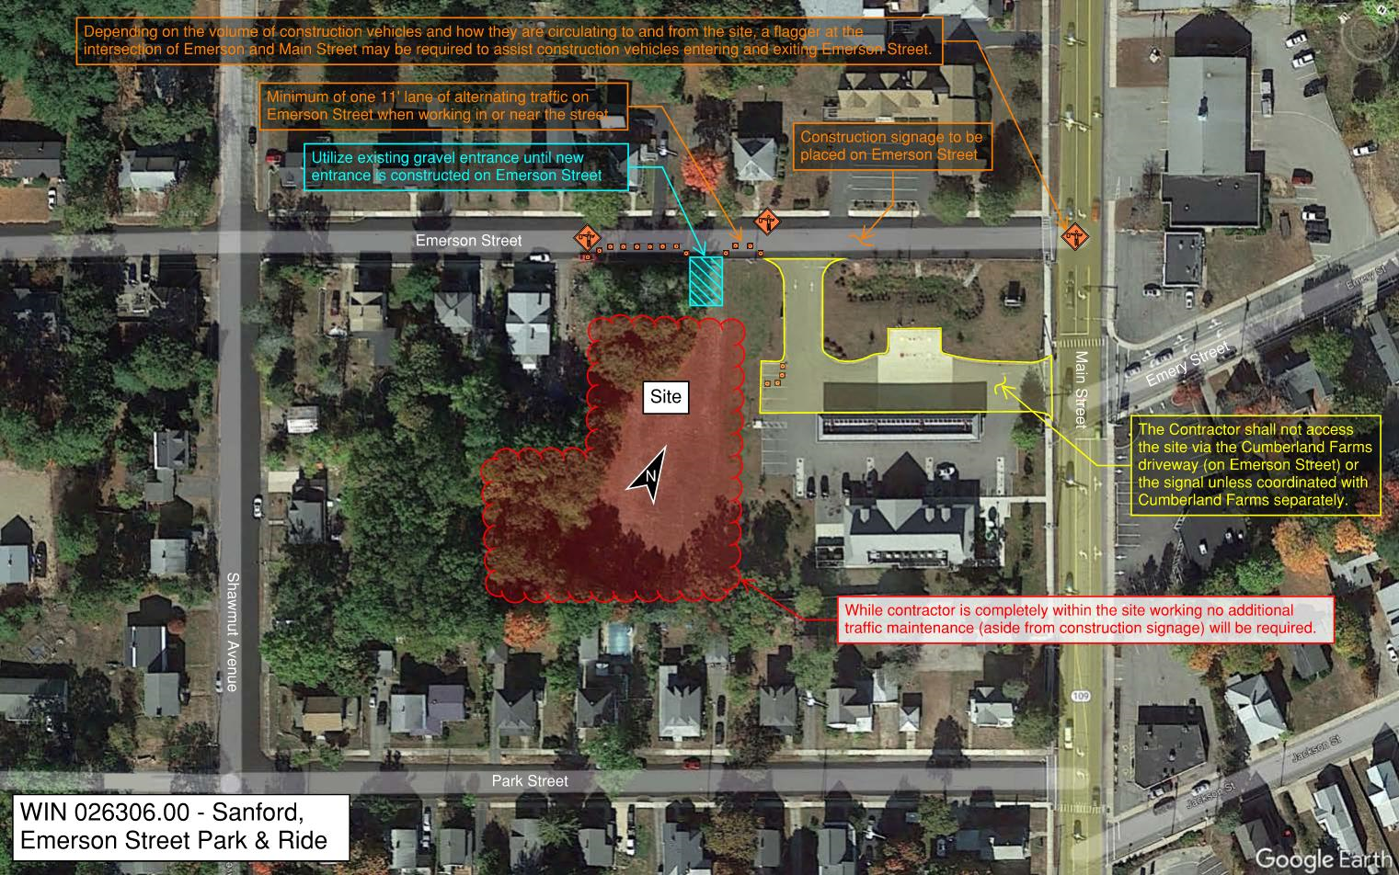
Emerson Street Park & ride
Located off the main roads.
Schedule will likely not be dictated to the Contractor.
Work can be completed alongside any of the other projects as it does not have a significant impact on traffic or the general public.
Substantial Completion expected by Summer of 2030 at the latest.
Traffic control will likely be limited to flaggers along Emerson Street.
A flagger may be posted intermittently on Main Street to help construction vehicles enter/exit the site.
Site access for construction vehicles should be through Emerson Street.

Slide 12
Project Timeline
Construction Phasing Meeting Tonight 11/20/25
Right of way process is underway
Final Mapping
Appraisals
Negotiations
Project Plans, Specs & Estimate- July 2026
Project advertise- August 2026
Bid Openings- October 2026
Project award- December 2026
Construction Begin- March/April 2027
Construction Complete- Winter 2030
Notes:
Talk on communications for each bullet, Constructability issues, Utility issues, right of way

Slide 13
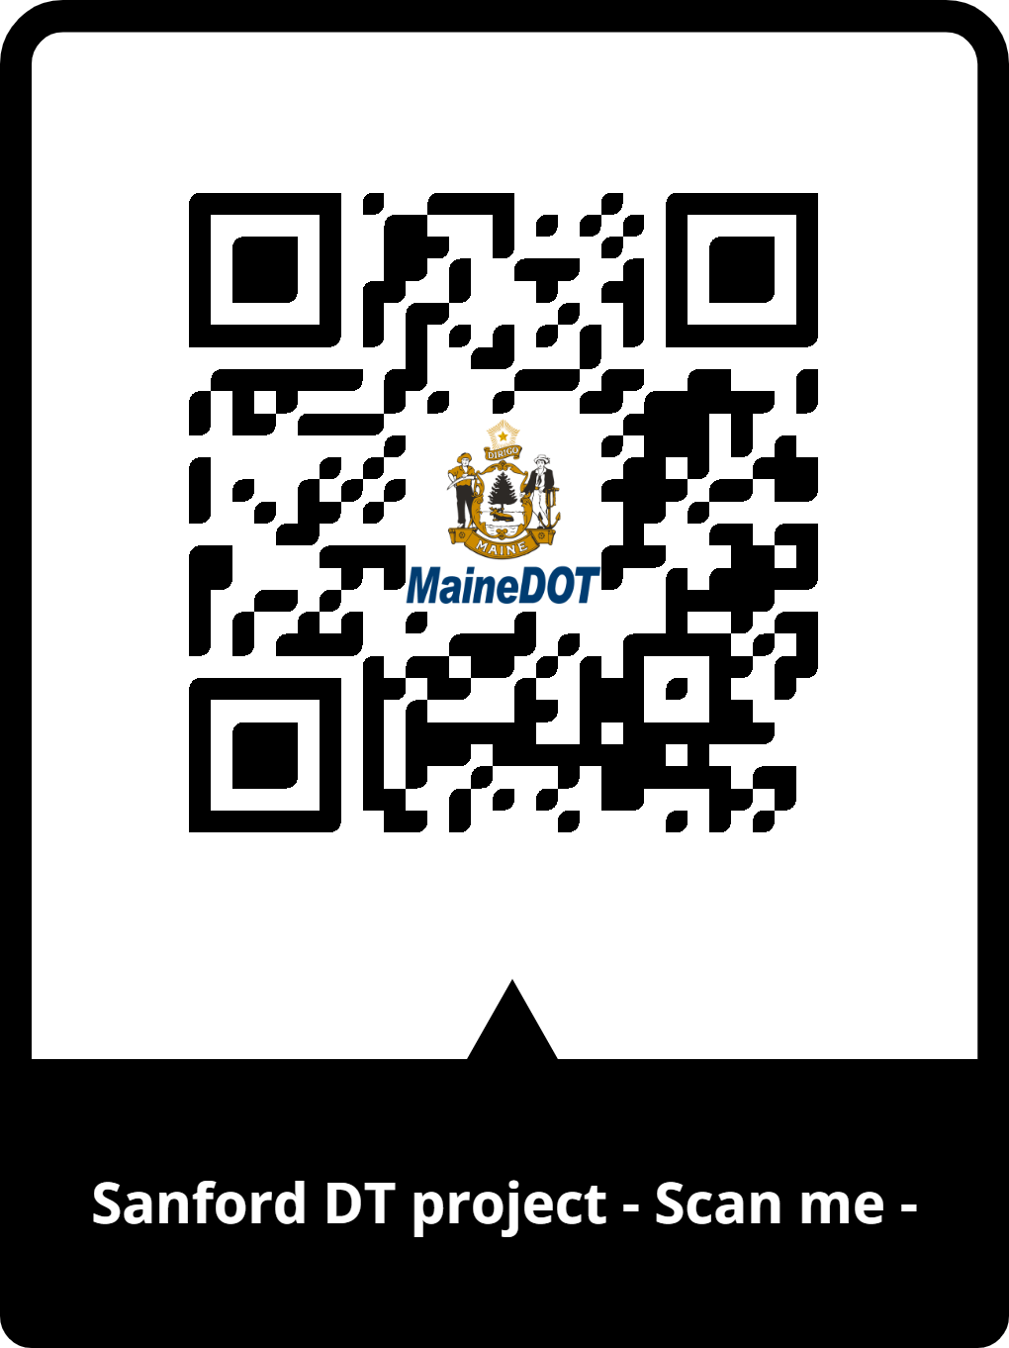
Construction Communications
Will pose a substantial disruptions to the Sanford Downtown area
However, MaineDOT will work with community to lessen impacts:
Public information plans
Sanford Downtown Revitalization Projects Webpage
QR Code to get to the Sanfor Downtown Revitalizations Projects Webpage (To use the QR code, just open the camera on your smartphone and point it at the code. A link should pop up on your screen that says open, tap it to open the webpage
Website notices, both State and City
Facebook
MaineDOT & Contractor to hold Open House before construction begins
Weekly contractor updates
Traffic management plan
Notes:
Talk on communications for each bullet, Constructability issues, Utility issues, right of way

Slide 14
Project CONSTRUCTION Funding
Federal RAISE Grant Funding Source $25,000,000
State Funding $3,005,888.00
City of Sanford $3,005,888.00
Federal Flexible Funding $647,104.00

Slide 15
Questions/answers/thoughts
Ground rules- in council chambers please raise your hand, when called upon, please stand up and state your name and who you are representing. If you’re attending on Zoom raise your hand in the chat and we will call upon you. One person at a time.

